Slide 1
Movie Recommendation Using Matrix Factorization
Akhil A Kumar
Rohith
Adithyan PK
Vignesh
Naga Dharshan
Amrita School of Computing | Amrita Vishwa Vidyapeetham | Amritapuri

Slide 2
CONTENTS
OBJECTIVES
DATA
METHODOLOGY
RESULT ANALYSIS
CONCLUSION

Slide 3
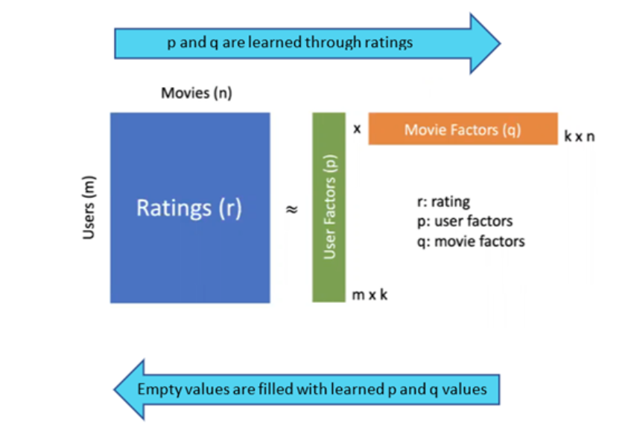
OBJECTIVES
The goal of this project is to develop a movie recommendation system that predicts user preferences based on past ratings.
Using the Singular Value Decomposition (SVD) algorithm, the system analyzes user and movie data to make personalized recommendations.
The final product is a user-friendly Streamlit app that delivers real-time recommendations for movies.

Slide 4
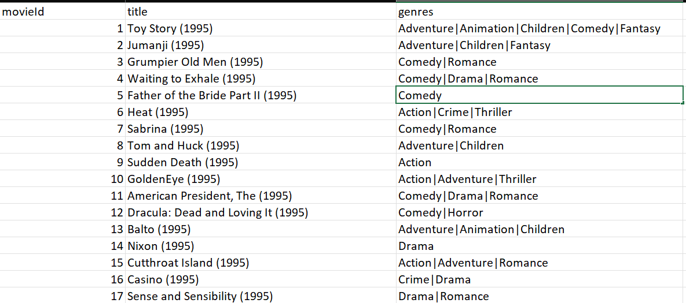
DATA

Slide 5
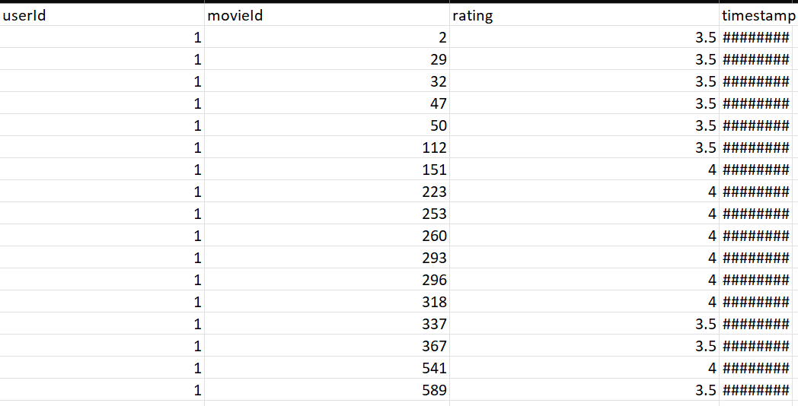
DATA

Slide 6
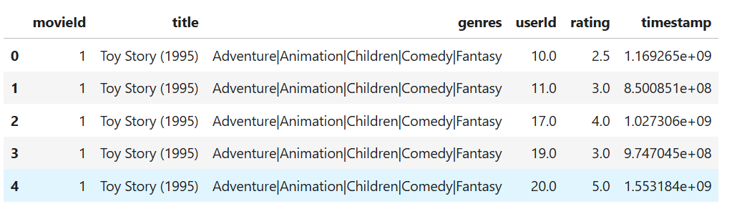
DATA

Slide 7
METHODOLOGY
Data Preparation:
Datasets:Movies Metadata: Information about movies (e.g., titles and genres) from movie.csv.User Ratings: User reviews and ratings for movies from rating.csv.
Data Merging:
These datasets were combined to create a unified structure, ensuring that each rating is linked to the corresponding movie details.

Slide 8
METHODOLOGY
1. Algorithm Selection:
The SVD (Singular Value Decomposition) algorithm was used, a popular choice for collaborative filtering. SVD identifies patterns in the user-movie interaction matrix to predict ratings for unrated movies.
2. Model Training and Evaluation:
The dataset was split into training and testing subsets to build and evaluate the model.
3. Metrics:
Standard accuracy measures like RMSE were used to gauge the performance of predictions.

Slide 9
METHODOLOGY
4. Hyperparameter Optimization:
To improve the model’s accuracy, GridSearchCV was employed to find the best combination of SVD parameters.
5.Application Development:
A Streamlit-based web application was created for interactive movie recommendations.
The app includes features like:
A search bar to find specific movies.
A visually appealing interface with a background image and intuitive design.

Slide 10
RESULT
Data Insights:
A merged dataset showcasing movies and user ratings was successfully created.
A sample dataset with movies like The Dark Knight and Blade Runner demonstrates how the system works.
Model Performance:
The SVD model showed promising results with accurate predictions for user preferences.
Hyperparameter tuning improved the system’s ability to recommend movies effectively.

Slide 11
RESULT
Interactive App:
Users can interact with the app to receive personalized movie recommendations.
The app integrates well-designed visual elements and functionality for an engaging user experience.

Slide 12
RESULT ANALYSIS
Strengths:
The model performs exceptionally well for frequent users and popular movies, with predictions aligning closely to real ratings. SVD’s collaborative filtering approach helps discover hidden user-movie relationships, offering diverse recommendations.
Limitations:
Accuracy for new or infrequent users (cold start problem) remains a challenge due to limited data. The model’s reliance on numeric ratings might overlook contextual factors like user mood or situational preferences.

Slide 13
RESULT ANALYSIS
Future Improvements:
Incorporate hybrid recommendation methods by combining collaborative filtering with content-based filtering.Expand datasets to include additional user metadata (e.g., demographics) and contextual movie attributes.

Slide 14
CONCLUSION
This project successfully demonstrates the implementation of a movie recommendation system leveraging the Singular Value Decomposition (SVD) algorithm. By combining robust machine learning techniques with a user-friendly Streamlit interface, the system provides accurate and personalized movie recommendations based on user ratings.

Slide 15
KEY ACHIEVMENTS
Effective preprocessing and integration of movie metadata and user ratings.
High model accuracy, validated through rigorous performance metrics like RMSE.
A dynamic and visually appealing application that simplifies user interaction with advanced recommendation algorithms.
The results showcase the potential of collaborative filtering in understanding user preferences and delivering tailored recommendations.
While the system performs well, addressing challenges like the cold start problem and integrating hybrid techniques could further enhance its functionality.
This project paves the way for developing more sophisticated and inclusive recommendation systems, ensuring improved user satisfaction and engagement.

Slide 16
THANK YOU

